Slide 1

Turi Create
https://github.com/apple/turicreate
Marvin Lin

Slide 2

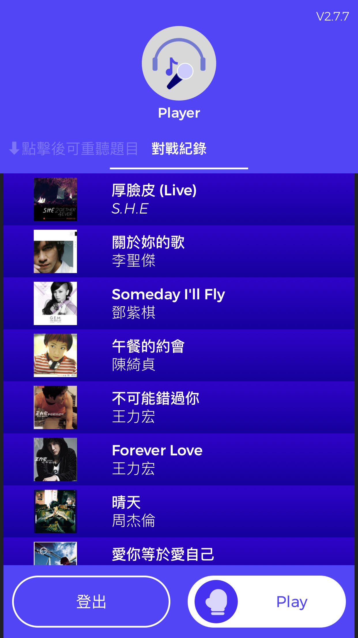
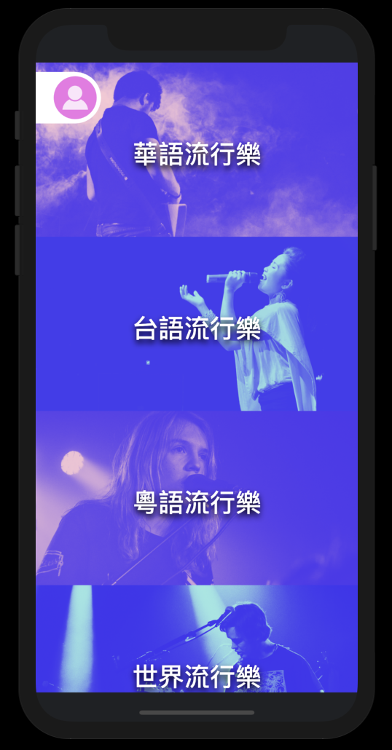
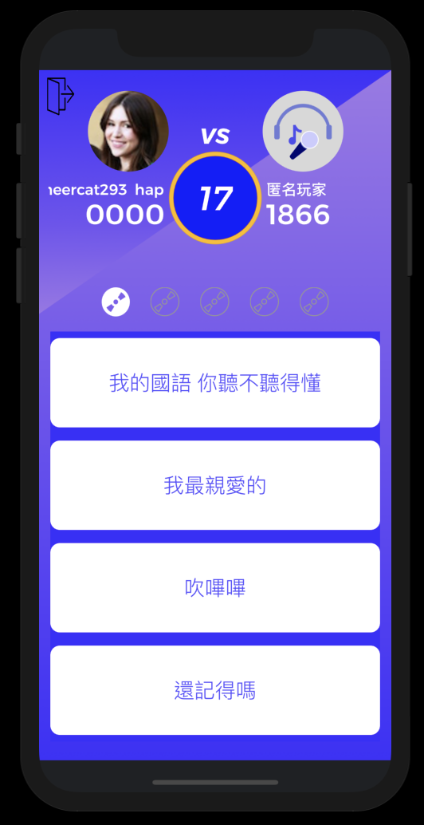
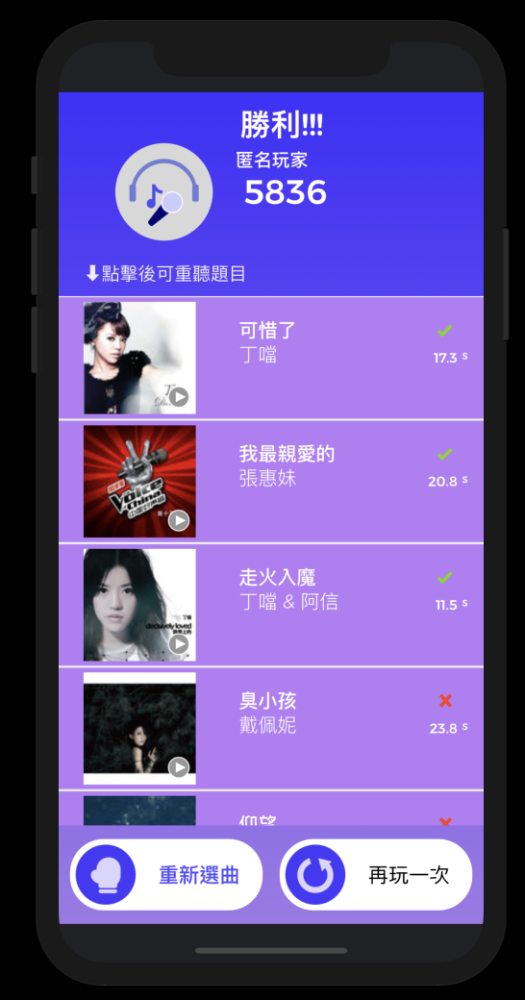
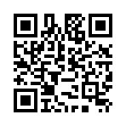
My App
King of Song quiz
Download From App Store
https://tinyurl.com/y9cg9fjr

Slide 3
WWDC18 - Session 712 - Turi Create
Sessions related to Core ML in WWDC18
703 - Introduction Create ML
708 - What’s new in Core ML - Part 1
709 - What’s new in Core ML - Part 2
713 - Introducing natural language framework
716 - Object tracking in vision
717 - Vision with core ML
Related to Python
712 - A guide to Turi Create
719 - Core Image performance prototyping and Python
This repository can let you download all sessions information in one line.
https://github.com/ohoachuck/wwdc-downloader
./wwdc2018.swift
Usage: wwdc2018.swift [--hd] [--sd] [--pdf] [--pdf-only] [--sample] [--sample-only] [--sessions <s1 s2 ...>] [--list-only] [—help]

Slide 4
What is Turi Create?
It’s an Python package, open source project. Let you make Core ML models easier than before.
Easy to use, you don’t have to be a ML expert.
Let iOS developer can focus on APIs
You can use it in different platform (Mac, Linux)
Easy to use
- pip install turicreate ( Mac already have Python 2.7)
- Less than 20 lines of code.
- Jupyter Notebook (Not necessary)
- Python Virtual Env (Not necessary)
https://github.com/apple/turicreate

Slide 5
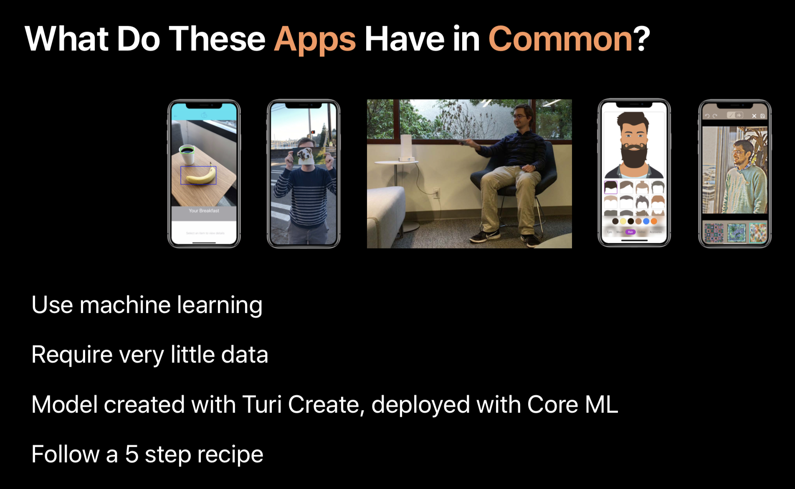
Detect Objects
Realtime detecting
Gesture
Recommend
Style Transfer

Slide 6
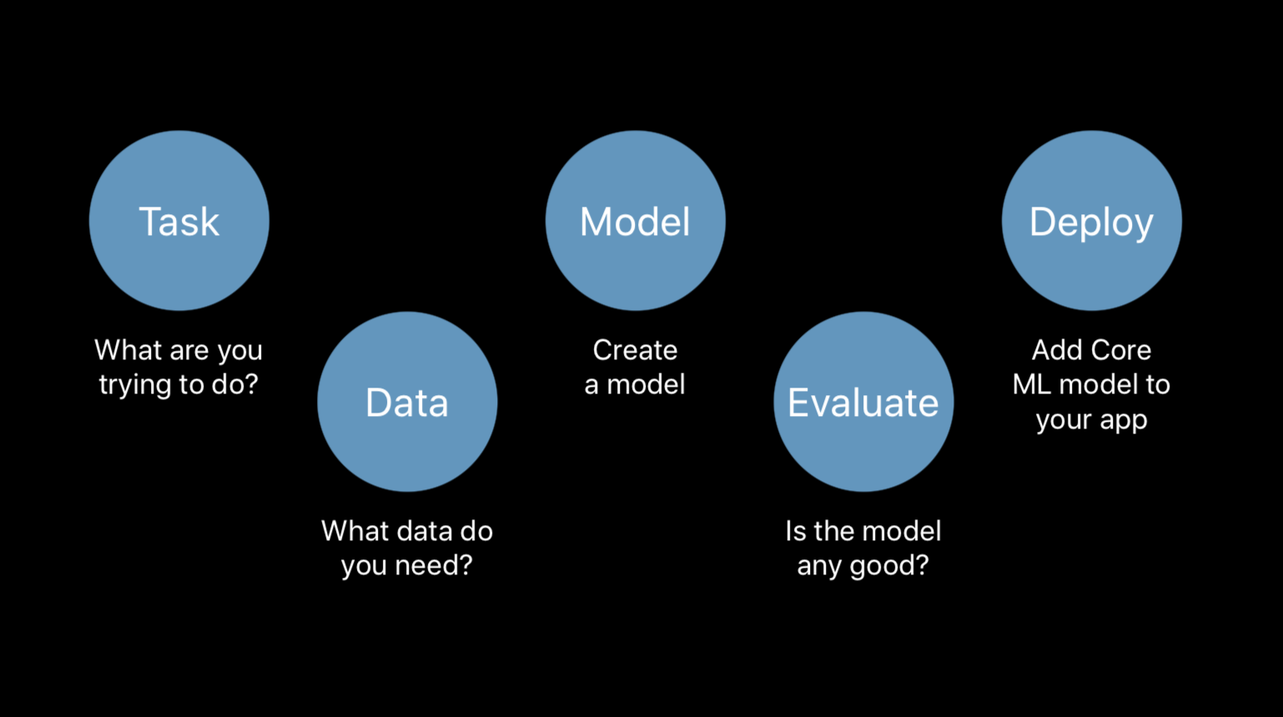
5 steps for make a ML App

Slide 7
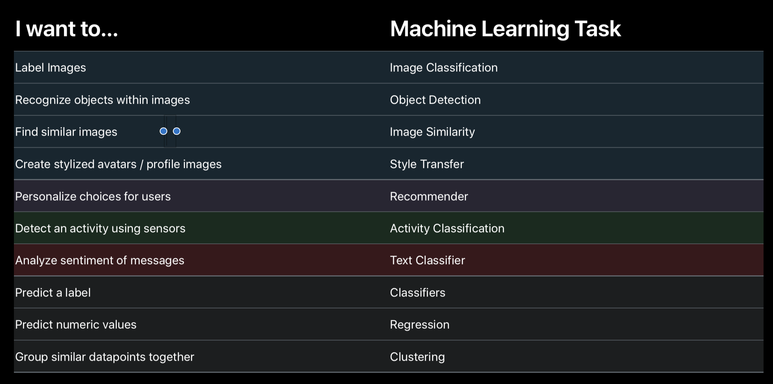
ML Tasks vs. Task Names

Slide 8
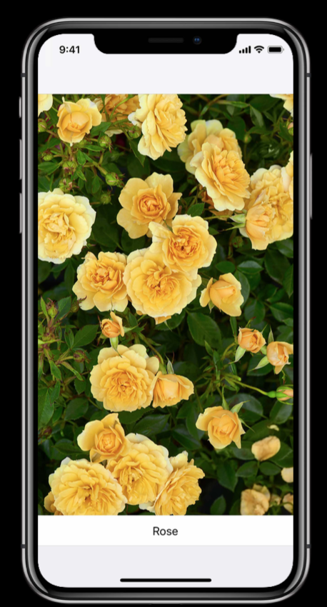
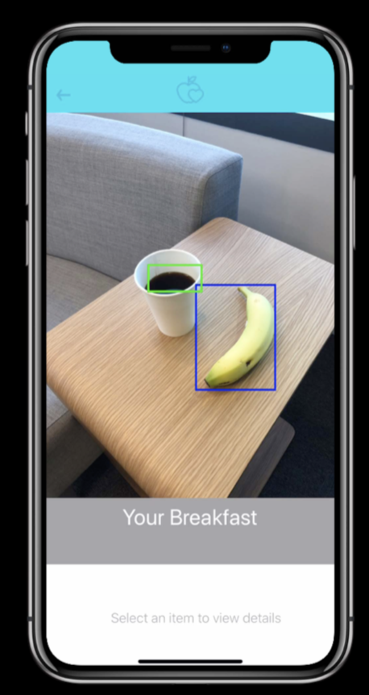
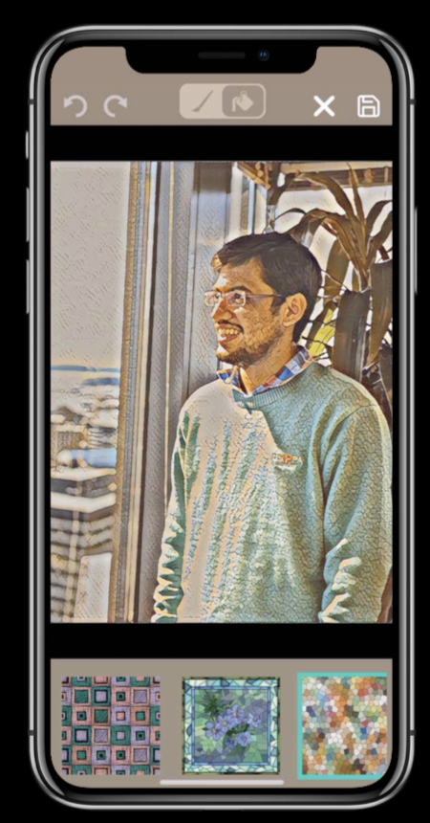
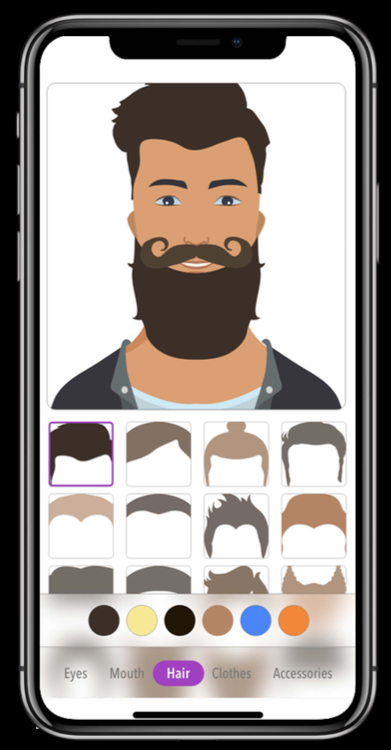
Step 1: ML Tasks
Image Classification
Object Detecting
Style Transfer
Personal Recommendation
After 5.0 beta

Slide 9
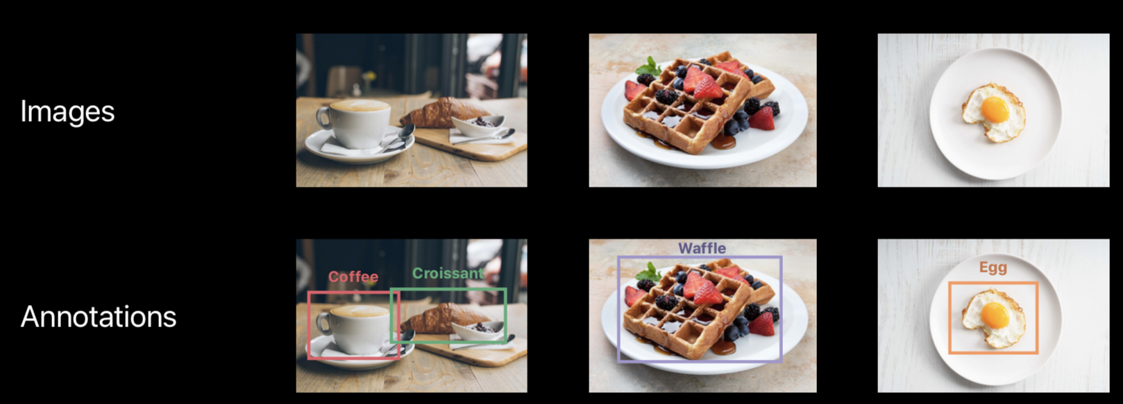
Step 2: Data

Slide 10
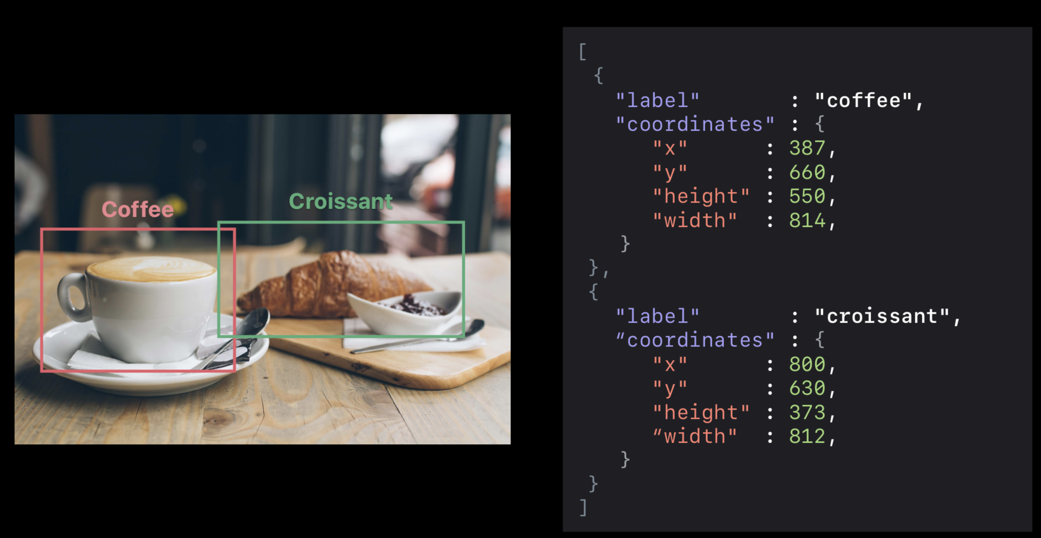
Step 2: Data
There are two kind of index in data. One is label, the other one is coordinates.
The X, Y is center of image.

Slide 11
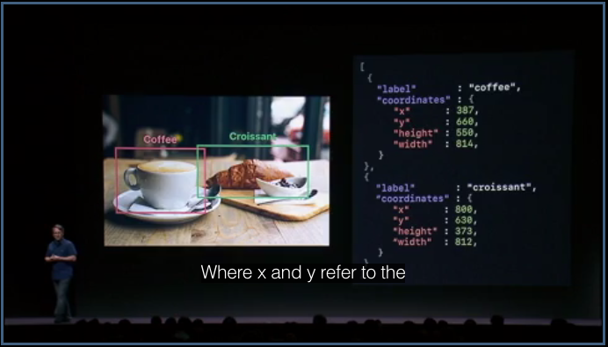

Step 2: Data
X and Y refer to the center of the bounding box.

Slide 12
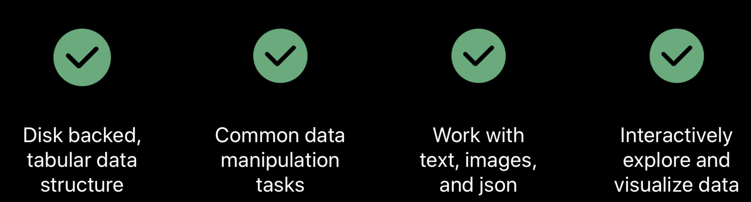
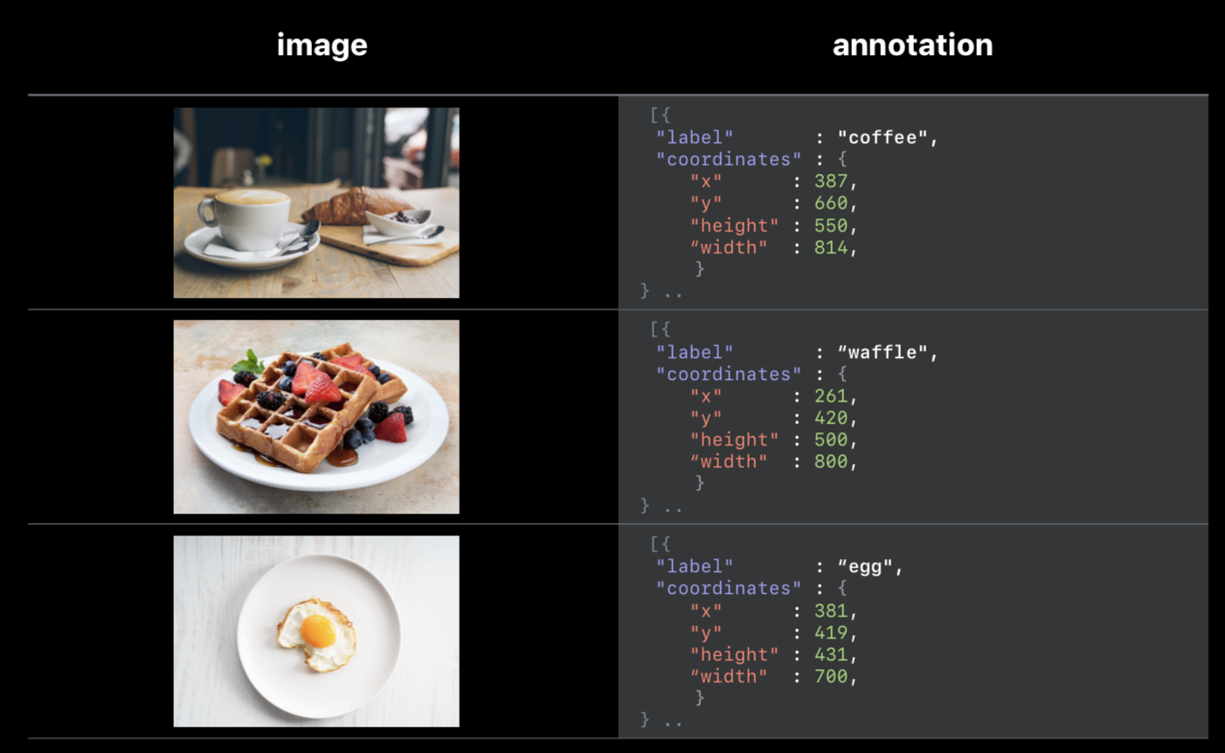
SFrame Data Struct

Slide 13
Let’s build a model
Task: Recognize the picture is Kaneshiro or not.
XCode: Project_KaneshiroOrNot
Task: Recognize the picture is soup or rice.
XCode: Project_SoupOrRice
You can download the project from this GitHub repository
https://github.com/MoonAndEye/TuriCreateDemo

Slide 14
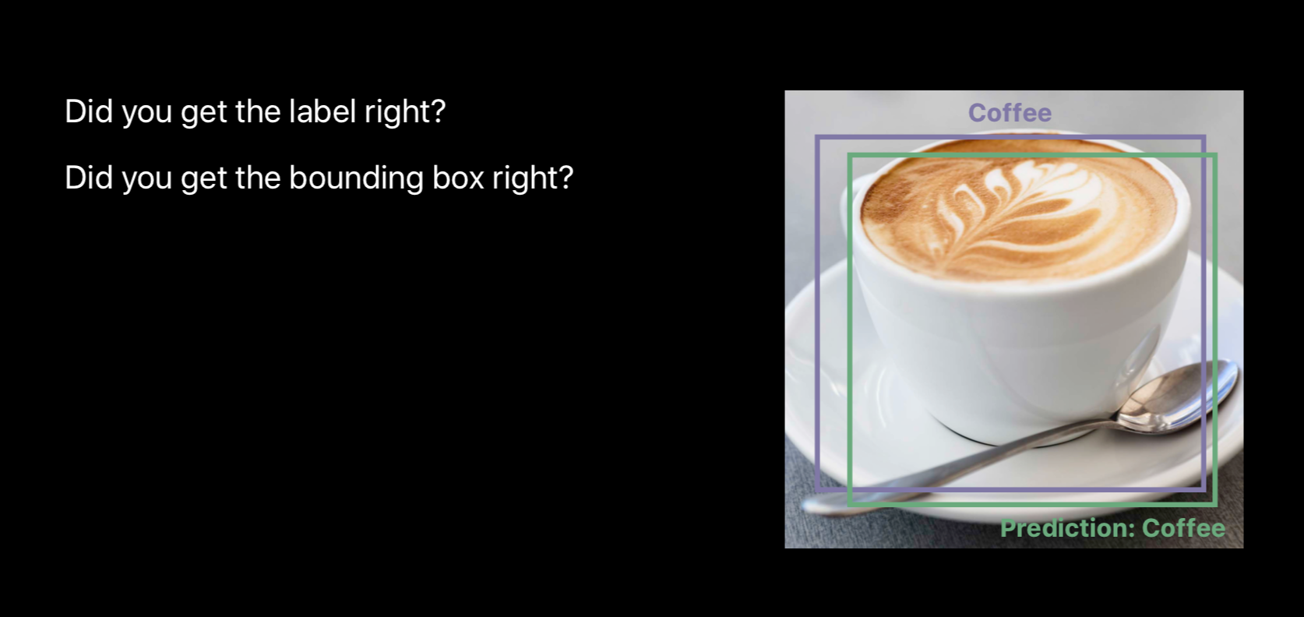
Evaluating the model

Slide 15
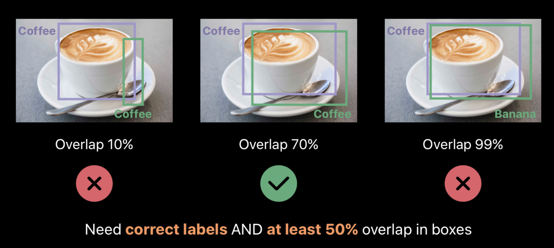
Examples

Slide 16
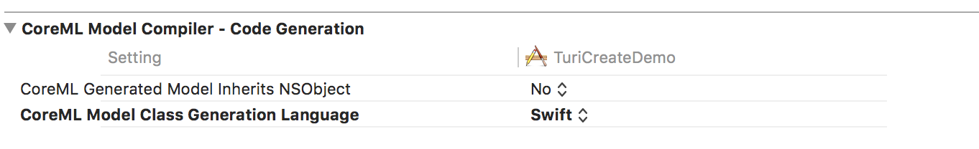
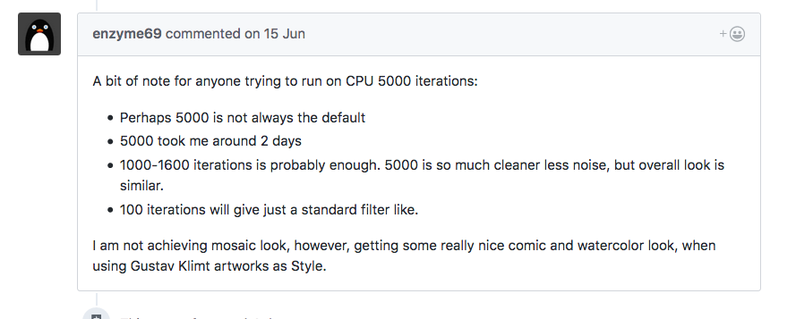
Some trouble you might encounter
If you have two models in a project, it might failed to run in sometimes.
Change “Generation Language” from Automatic to Swift (in Build Setting)
Sometimes there have undeclared error occurred in swift fire which created from XCode.
Clear derived data and build again.
When you want to build a style transfer model, the default iteration is 5000. ( It might cost you two days).

Slide 17
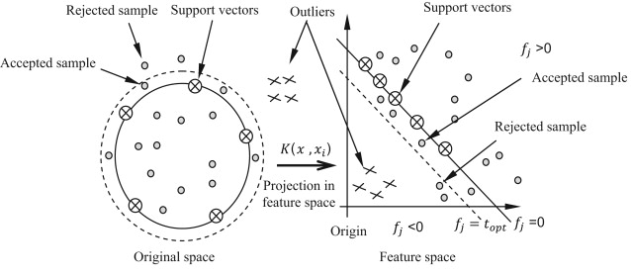
Knowledge outside of iOS
Define the task, is the answer of Kaneshiro or not is a problem of “One classification”?
One classification
Or Image Classification?
Or Face detection plus Object Detect?
The characters in machine vision is not the same as your brain.

Slide 18
Where to go from here?
The sessions relative to Machine Learning in WWDC18
703 - Introduction Create ML
708 - What’s new in Core ML - Part 1
709 - What’s new in Core ML - Part 2
713 - Introducing natural language framework
716 - Object tracking in vision ☆
717 - Vision with core ML ☆
Models that already trained
https://developer.apple.com/machine-learning/build-run-models/
Turi Create sample code
https://apple.github.io/turicreate/docs/userguide/
Style Transfer ( new feature in 5.0 beta)
https://apple.github.io/turicreate/docs/userguide/style_transfer/
Coco data set
http://cocodataset.org/#home

